Slide 1






Signature Biometric Identification

Slide 2
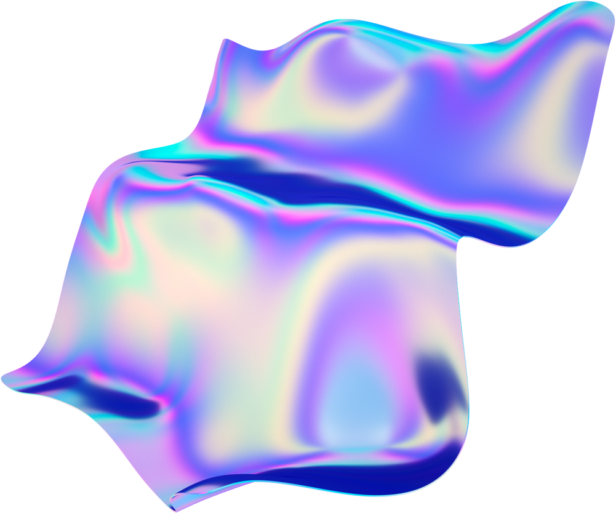

Table Of Content
Q1
Q2
Q3
Dataset
Segmentation
Preprocessing using Filters
Classification Model
Encryption and Decryption

Slide 3

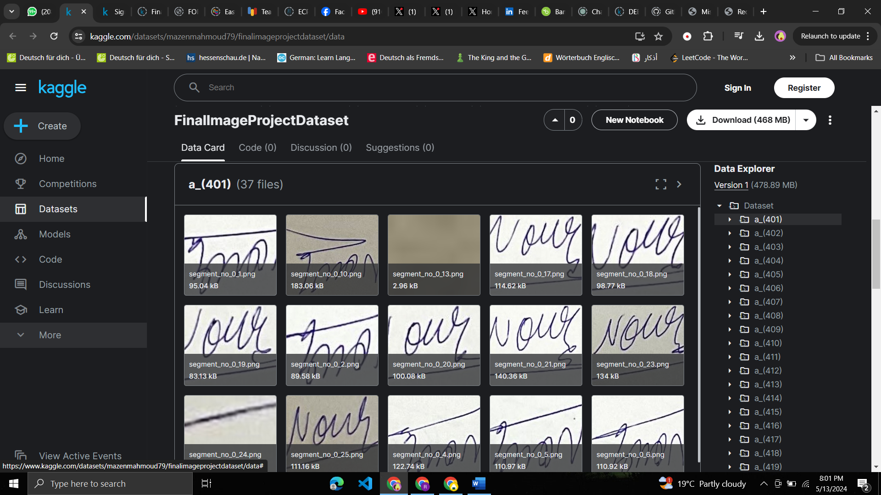
1- Dataset
It’s 420 directories. Each one of them has it’s own files.
Each image is about Handwritten Signature.

Slide 4
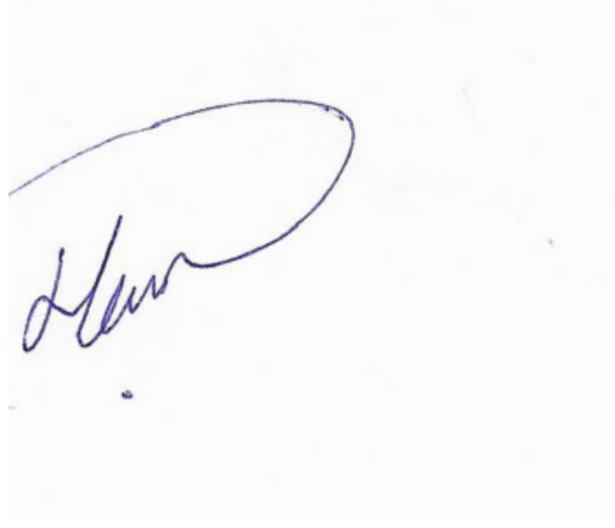
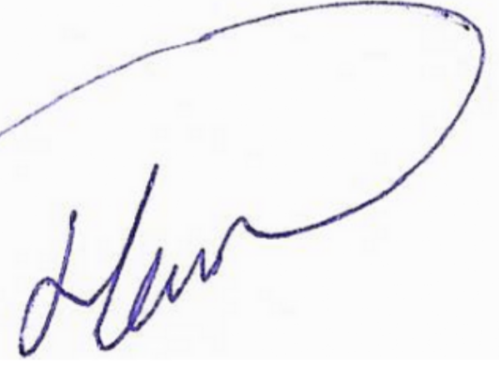
Segmentation
Before Segmentation
After Segmentation

Slide 5
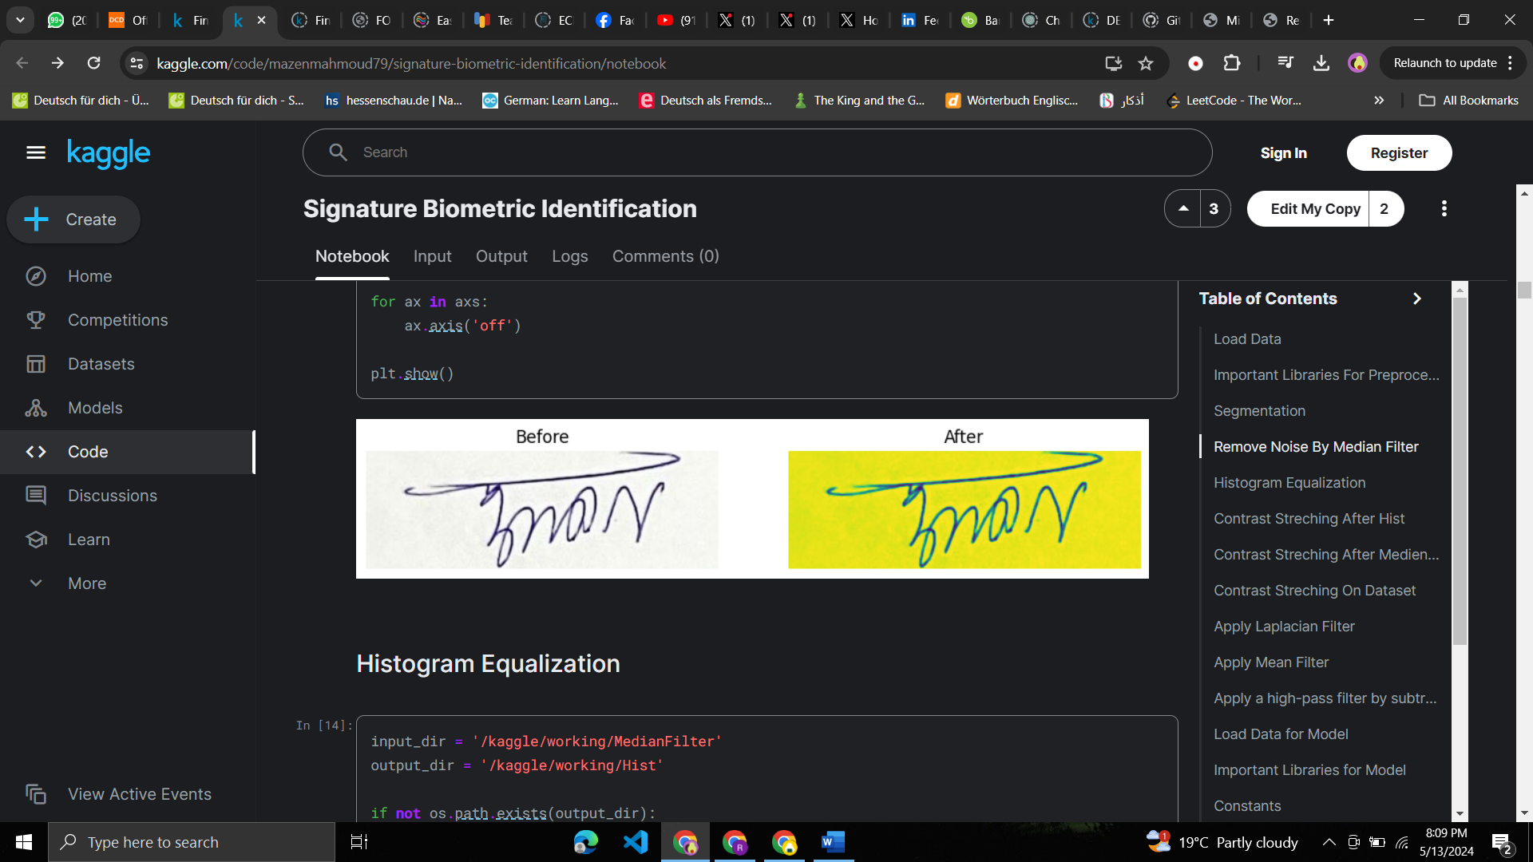
2- Preprocessing By Median Filter
it is valuable for its ability to effectively reduce noise, including outliers, while preserving edges and fine details, making it a computationally efficient and straightforward technique to enhance image quality.

Slide 6
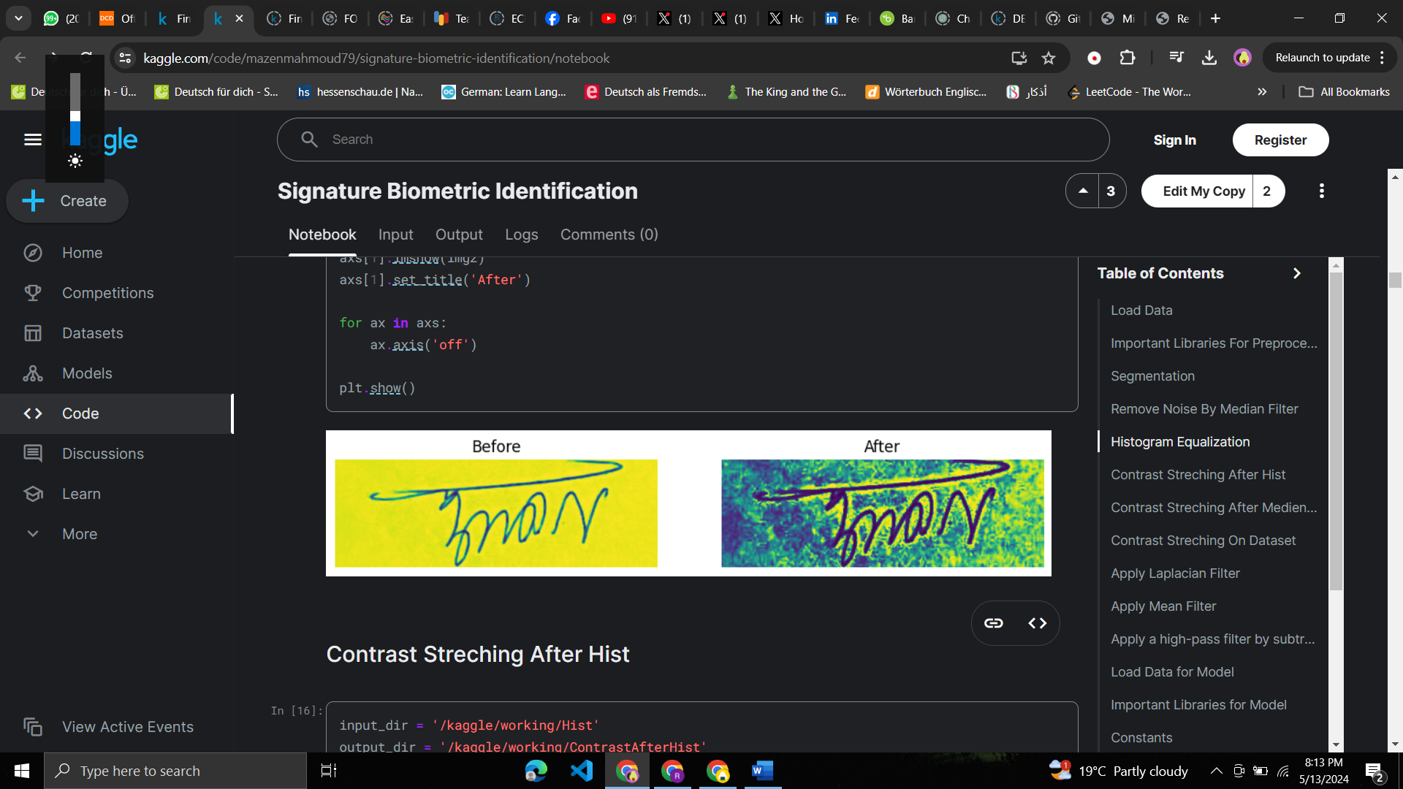
Preprocessing by Histogram Equalization
it redistributes intensity values to spread them across a wider range, enhancing the image's overall appearance and making it more visually appealing.

Slide 7
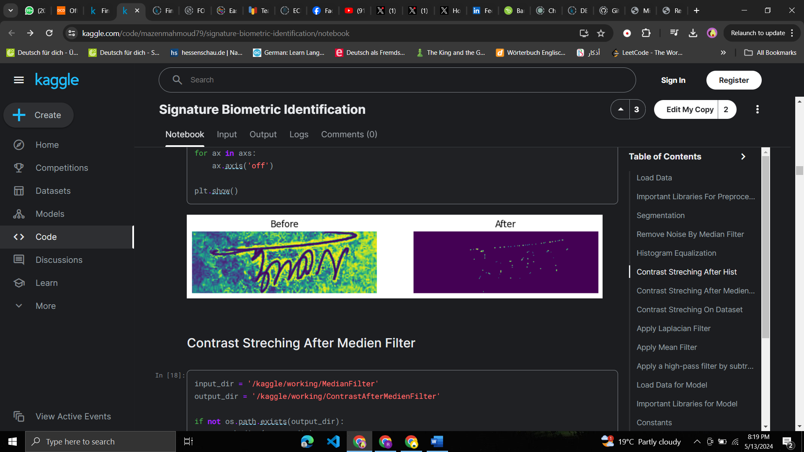
Preprocessing by Contrast Streching
it increases the contrast between different objects or features in the image. This is achieved by stretching the intensity values of the image to utilize the full available range, which can make the image appear more visually appealing and easier to interpret.

Slide 8
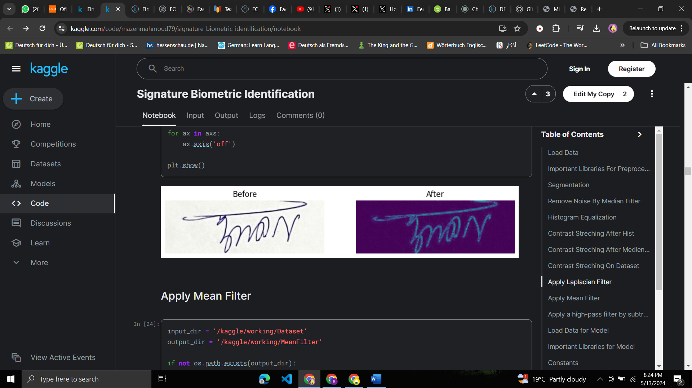
Applying Laplacian Filter
it enhances edges and fine details by highlighting regions of rapid intensity changes, improving the overall sharpness and clarity of the image.

Slide 9
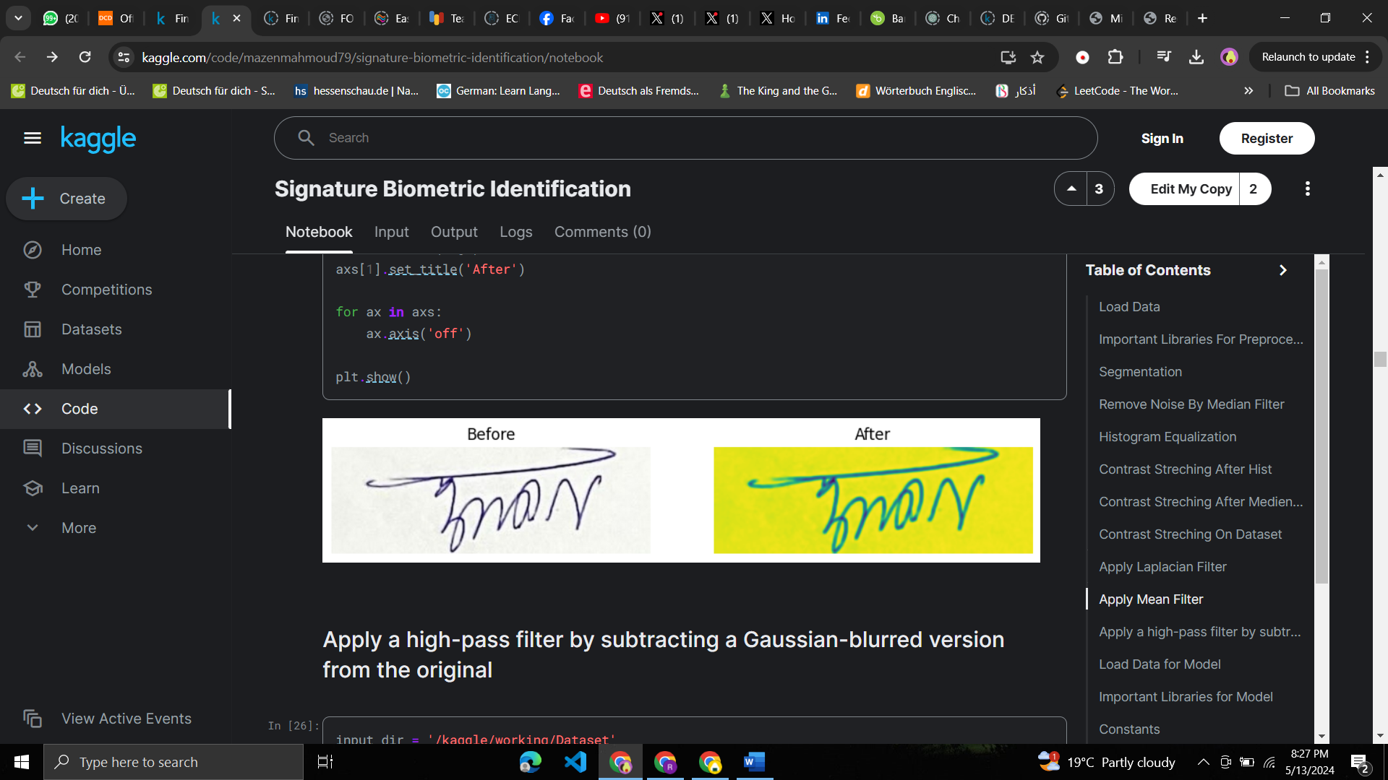
Applying Mean Filter
it is for smoothing or blurring an image, which helps reduce noise and detail, leading to a more uniform appearance

Slide 10
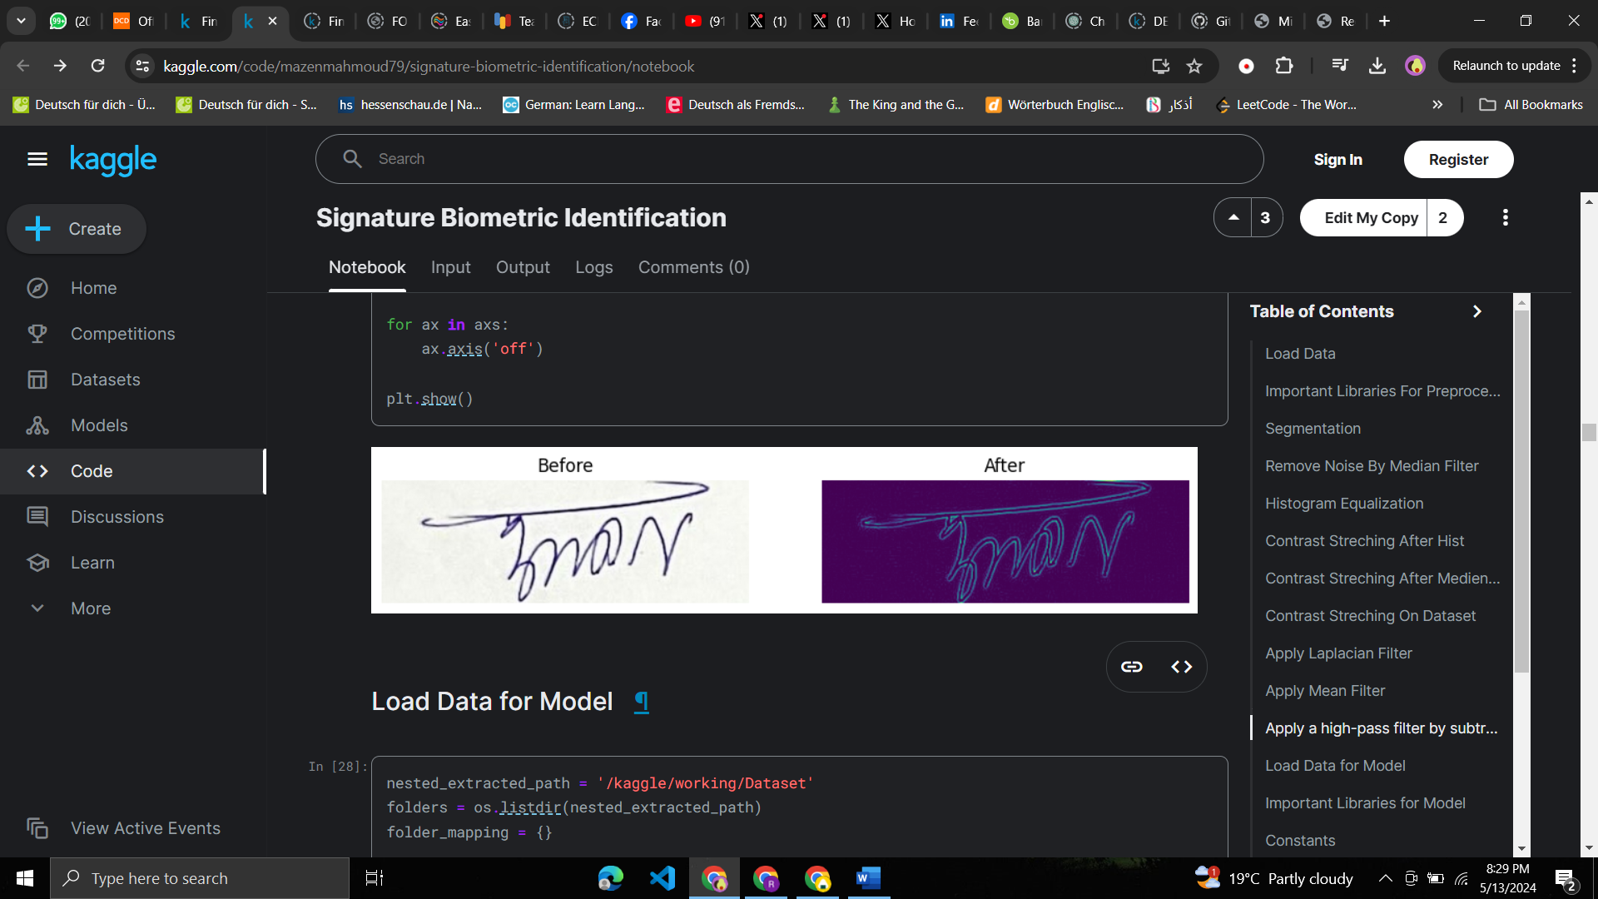
Applying High Pass Filter
it enhances high-frequency components in an image, such as edges and fine details, while suppressing low-frequency components, such as smooth areas or gradients.
This can help in sharpening the image and highlighting important features.

Slide 11
Augmentation
To increase the robustness of our deep learning models for signature recognition, we employed several data augmentation techniques. These techniques aim to artificially increase the size of the training dataset by applying transformations to the original images.

Slide 12
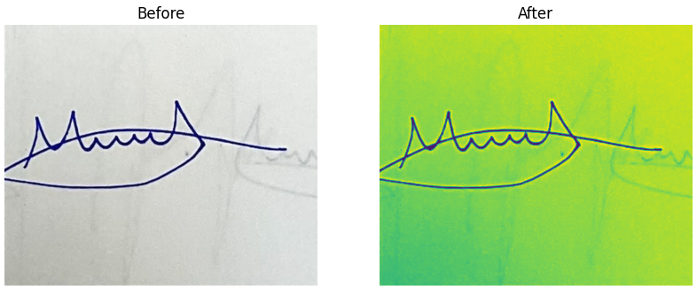
Augmentation : Reduce Line Thickness
One of the augmentation techniques used is reducing the line thickness of the handwritten text. This technique helps to simulate the variability in writing styles and instruments.

Slide 13
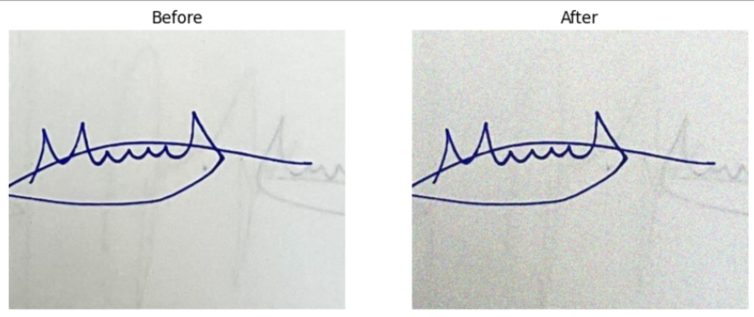
Augmentation : Add Random Noise
Another technique used is adding random noise to the handwritten text. This technique helps to simulate the noise and distortions that may occur during image acquisition or transmission.

Slide 14
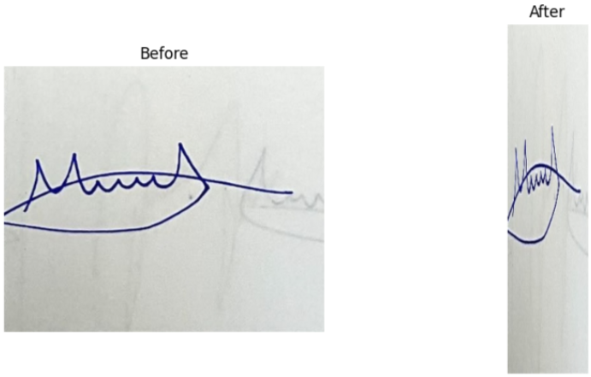
Augmentation : Apply Random Stretch
We also applied random stretch to the handwritten text, horizontally stretching the image by a random factor between -0.9 and +0.1. This technique helps to simulate the variability in writing sizes and orientations.

Slide 15
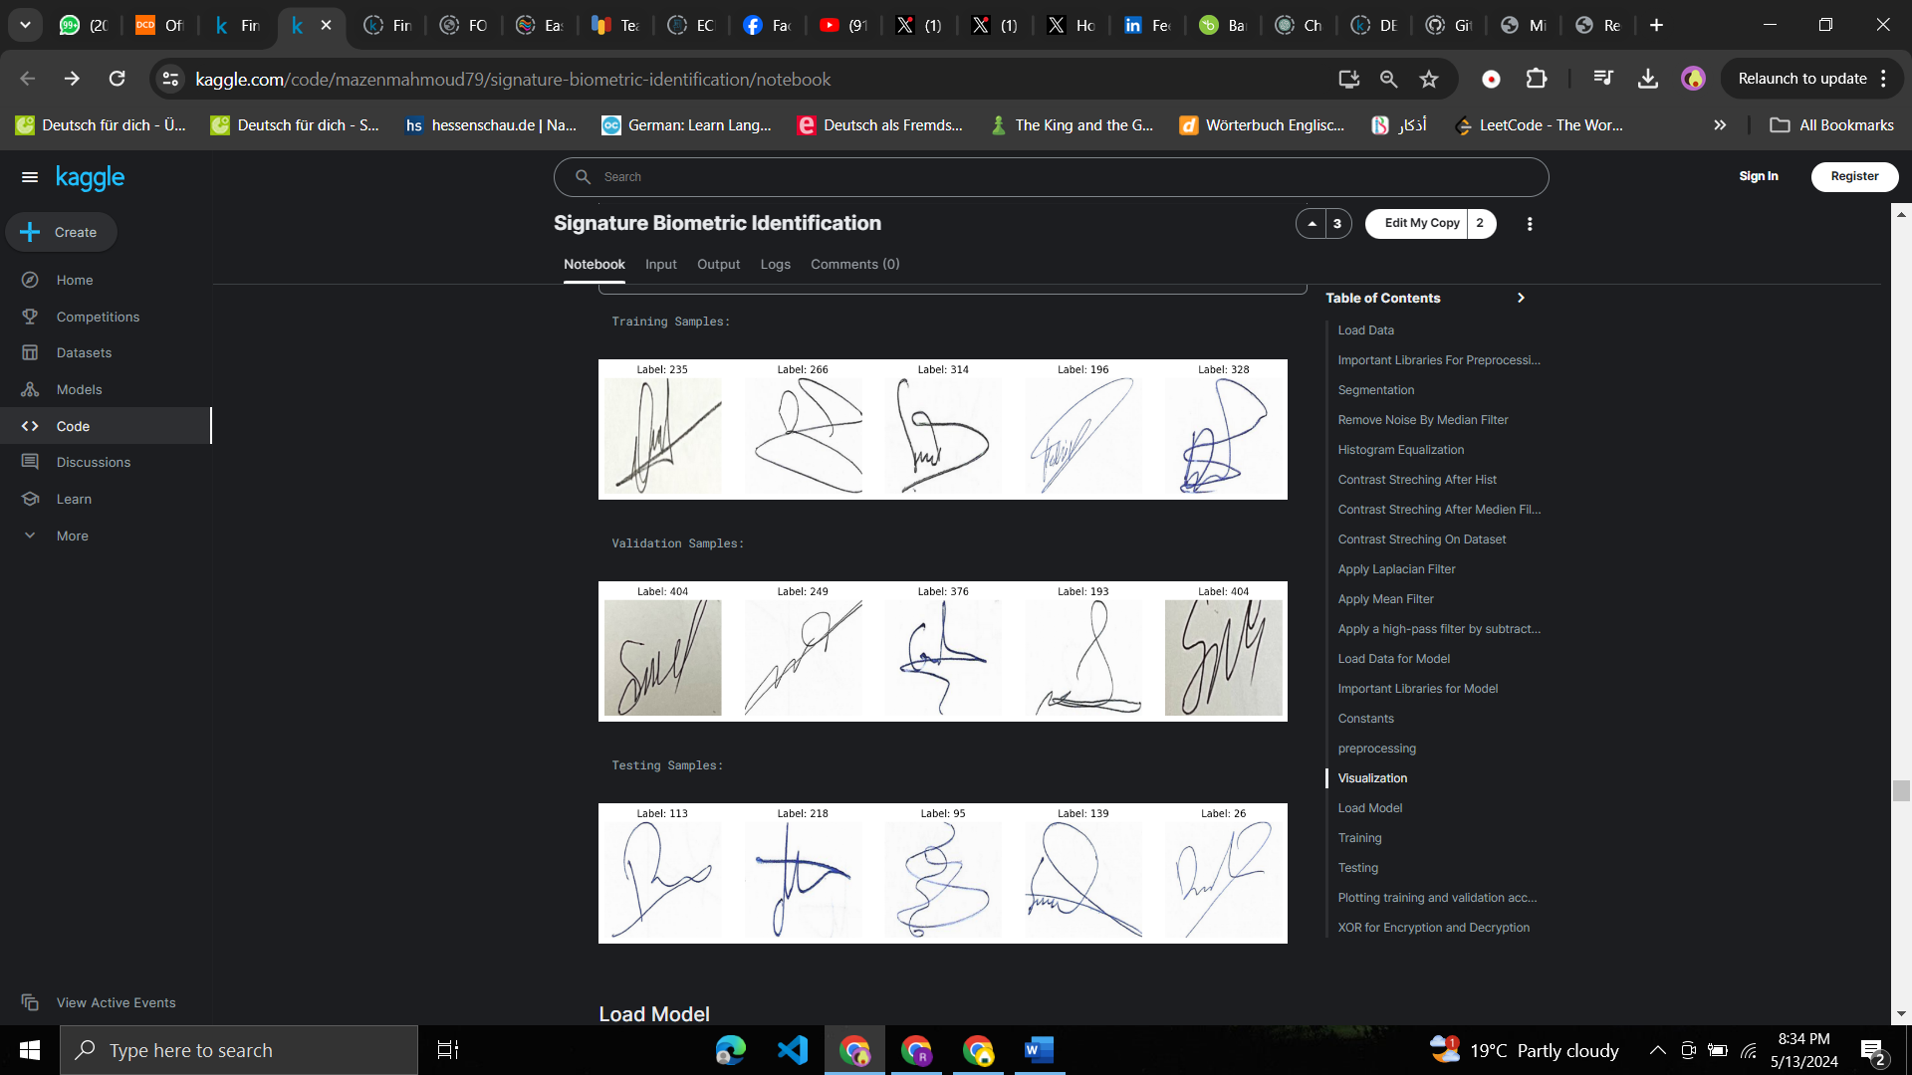
3- Classification Model
80% for training.
10% for validation
10% for testing
we used MobileNetV2 and got 98.33%
accuracy.

Slide 16

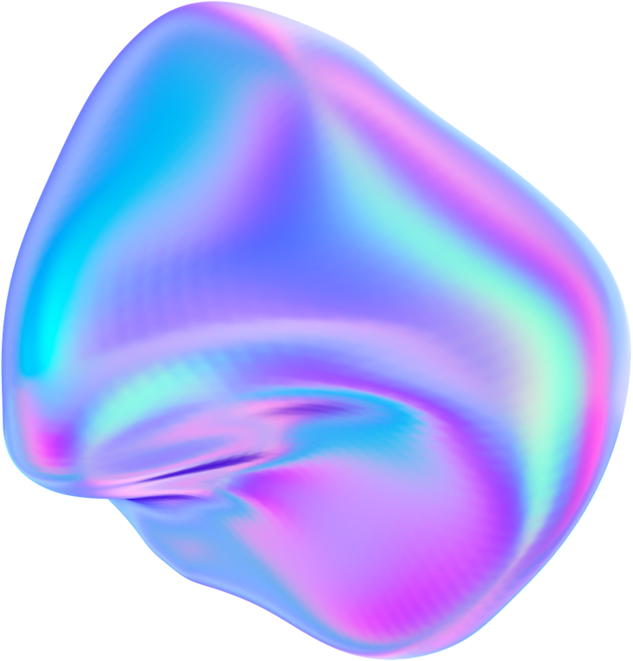
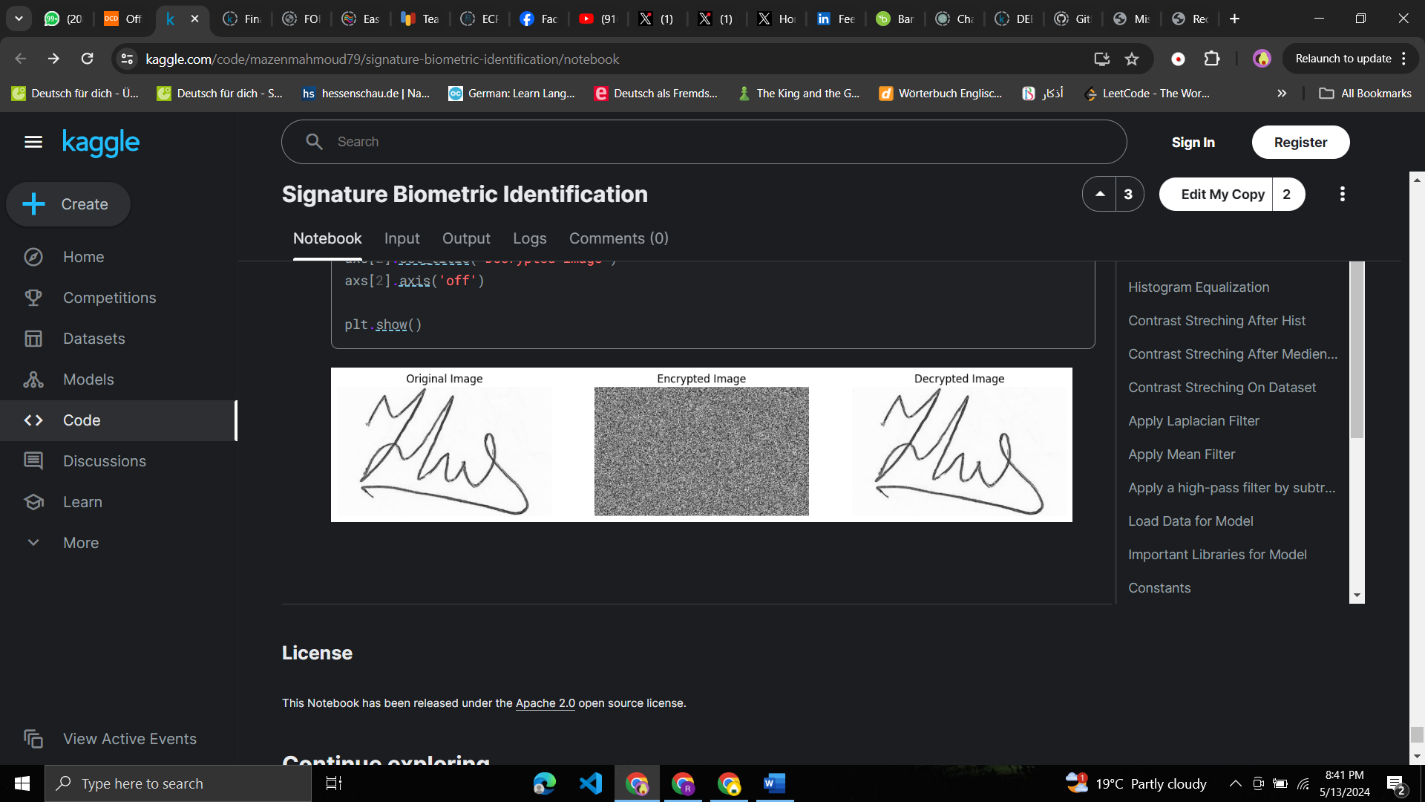
Encryption and Decryption
XOR METHOD
Product 1

Slide 17

Thank You
Bonus Please

